Slide 1
Contemporary Moral Problems
M-F12:00-1:00SAV 264
Instructor: Benjamin Hole
Office Hours: everyday after class
Email: bvhole@uw.edu

Slide 2
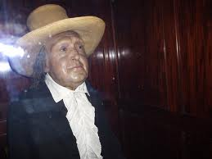
Agenda
Clicker Quiz
Bentham
We will discuss Nozick as a way of critically engaging with Bentham’s hedonism.

Slide 3

CLICKER QUIZ
Please set your Turning Technology Clicker to channel 41
Press “Ch”, then “41”, then “Ch”

Slide 4
According to Rachels, to coherently believe that cultural tolerance is objectively valuable:
one must be a cultural relativist.
one need not be a cultural relativist.
none of the above.

Slide 5
Bentham’s principle of utility states that:
an action is good to the extent that it promotes the happiness of all it affects
it does not matter whether an action is right, only whether it is useful to the agent in question.
we should never treat others as a mere means to our own ends.
we ought to do unto others as we would want to have them do unto us.
an is good to the extent that it promotes the greatest perfectionist value for the greatest number of people.
all the above.
none of the above.

Slide 6
According to Bentham, considerations of pain and pleasure determine:
what we ought to do.
what we will do.
both a and b.
neither a nor b.

Slide 7
Jeremy Bentham (1748-1832)
“The Principle of Utility”
Excerpted from
An Introduction to the Principles of Morals and Legislation, Chapters 1-4

Slide 8
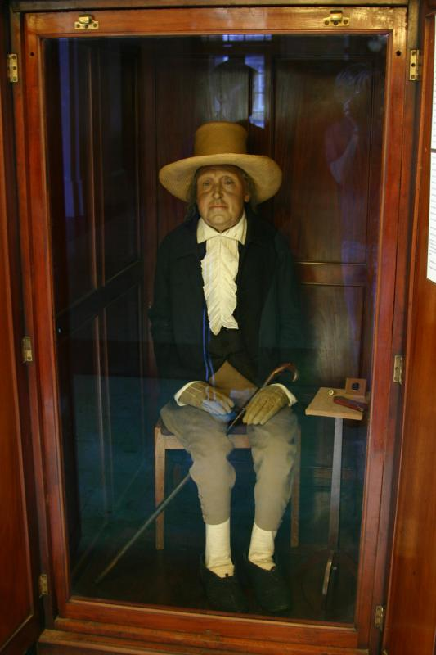
Jeremy Bentham (1748-1832)
“Influenced by many enlightenment thinkers, especially empiricists … Bentham developed an ethical theory grounded in a largely empiricist account of human nature. He famously held a hedonistic account of both motivation and value according to which what is fundamentally valuable and what ultimately motivates us is pleasure and pain.”
http://www.iep.utm.edu/bentham/

Slide 9
Jeremy Bentham (1748-1832)
Bentham today
He is stuffed, and on display at UC London. He still attends faculty meetings, but does no longer votes.

Slide 10
Jeremy Bentham (1748-1832)
Hedonistic Utilitarian
“Hedons” or “Utils” =^{df} the basic units of pleasure
Bentham makes a calculus for maximizing “hedons” or “utils”.
Quantitative Hedonism:
Pleasures and pains differ by quantity only, not quality.
Notes:
Draw on board - maximizing

Slide 11
Bentham's hedonism
“Nature has placed mankind under the governance of two sovereign masters, pain and pleasure.”
Descriptive claim: All actions are motivated solely by considerations of pleasure and pain.
Normative claim: What we ought to do depends solely on considerations of pleasure and pain.
Notes:
11

Slide 12
A normative claim can be legitimately derived from a descriptive claim.
Strongly Agree
Agree
Somewhat Agree
Neutral
Somewhat Disagree
Disagree
Strongly Disagree

Slide 13
The principle of utility
“That principle which approves or disapproves of every action whatsoever, according to the tendency which it appears to have to augment or diminish the happiness of the party whose interest is in question.”

Slide 14
Arguing for the principle of utility
The principle of utility cannot be directly proven:
“That which is used to prove every thing else, cannot itself be proved: a chain of proofs must have their commencement somewhere.”
But considerations can be raised in its favor
Arguments for other principles often seem to rely on the principle of utility.
Other ethical theories face considerable problems.
Is this an acceptable case for the principle?
Notes:
14

Slide 15
The principle of utility
Strongly Agree
Agree
Somewhat Agree
Neutral
Somewhat Disagree
Disagree
Strongly Disagree

Slide 16
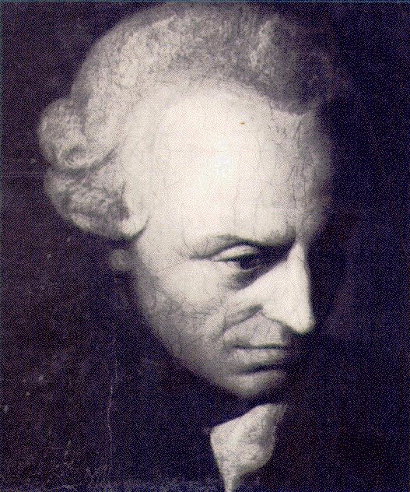
Bentham vs. Kant
Heteronomy
Bentham’s source of moral salience: sentience
Autonomy
Kant’s source of moral salience: agency

Slide 17
Bentham vs. Kant
Bentham’s source of moral salience: sentience
Moral Claims:
empirical
knowable a posteriori
contingent
Kant’s source of moral salience: agency
Moral Claims:
non-empirical
knowable a priori
necessary

Slide 18
How do we decide what to do?
We can calculate a number attached to the pain or pleasure of any given option. Bentham gives us a felicific calculus:
“To a number of persons, with reference to each of whom to the value of a pleasure or a pain is considered, it will be greater or less, according to seven circumstances: to wit, the six preceding ones; viz.
1. Its intensity.
2. Its duration.
3. Its certainty or uncertainty.
4. Its propinquity or remoteness.
5. Its fecundity.
6. Its purity. And one other; to wit:
7. Its extent; that is, the number of persons to whom it extends; or (in other words) who are affected by it”
Notes:
Calculable. Trying to do a science of ethics. The util.

Slide 19
How do we decide what to do?
We can calculate a number attached to the pain or pleasure of any given option. Bentham gives us a felicific calculus:
“Intense, long, certain, speedy, fruitful, pure - Such marks in pleasures and in pains endure. Such pleasures seek if private be thy end: If it be public, wide let them extend. Such pains avoid, whichever be thy view: If pains must come, let them extend to few.”
Notes:
Calculable. Trying to do a science of ethics. The util.

Slide 20
Hedonistic Utilitarianism
Strongly Agree
Agree
Somewhat Agree
Neutral
Somewhat Disagree
Disagree
Strongly Disagree

Slide 21
Summary & Worries
Key Features of Bentham’s Hedonistic Utilitarianism

Slide 22
Features of Bentham’s utilitarianism
(1) Value is a sensation; all the things we value are, in fact, reducible to sensory experience.

Slide 23
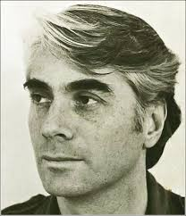
Features of Bentham’s utilitarianism
(1) Value is a sensation; all the things we value are, in fact, reducible to sensory experience.
Reductionism
Fetishism Argument

Slide 24
Value is a sensation; all the things we value are, in fact, reducible to sensory experience.
Strongly Agree
Agree
Somewhat Agree
Neutral
Somewhat Disagree
Disagree
Strongly Disagree

Slide 25
Features of Bentham’s utilitarianism
(2) Pleasures are homogeneous with respect to value.

Slide 26
Features of Bentham’s utilitarianism
(2) Pleasures are homogeneous with respect to value.
There are no “higher” or “lower” pleasures
There are no “bad” pleasures
Pleasures are both measureable & commensurable

Slide 27
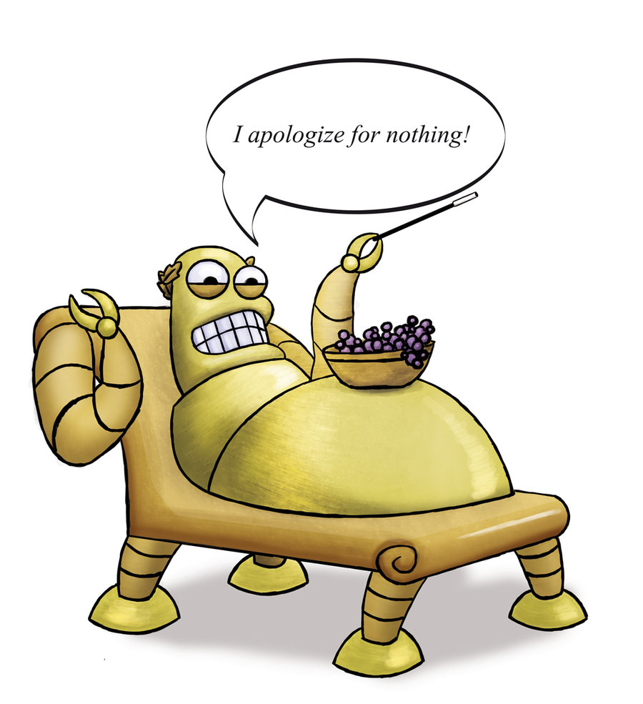
Features of Bentham’s utilitarianism
http://www.smbc-comics.com/?id=2569
(2) Pleasures are homogeneous with respect to value.

Slide 28
The homogeneity of value is a problem
Strongly Agree
Agree
Somewhat Agree
Neutral
Somewhat Disagree
Disagree
Strongly Disagree

Slide 29
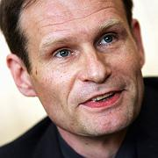

Features of Bentham’s utilitarianism
(3) Pleasures are given; it is not the job of the government to make people value things they don’t already like.

Slide 30
Bad pleasures are a problem.
Strongly Agree
Agree
Somewhat Agree
Neutral
Somewhat Disagree
Disagree
Strongly Disagree

